Slide 1
Recommendation for Big Mountain Resort
August 24, 2021

Slide 2
Problem identification
The executive team believes that the pricing for the resort is not optimal and would like some guidance on (1) the ideal price point and (2) possible changes in operations.
Main question:
How can Big Mountain maximize its profit by adjusting its prices and implementing operational changes for the next season?

Slide 3
Recommendation and key findings
Results from our analysis:
Our ML model recommends a ticket price of $94, which is 16% higher than the current ticket price of $81.
The resort should add a run that increases the vertical drop by 150 feet, which will require a new chair lift. With these changes, the ticket price can be increased by $2, adding another $3.5M to the revenue.

Slide 4
Modeling results and analysis
Dataset
The cleaned dataset has 277 resorts in the U.S., with 36 features derived from ski resort and state data.
ML model
The train/test split is 70/30.
Tested several ML models and hyperparameters on the training data with 5-fold cross-validation.
The final model is a Random Forest model with 69 trees, median imputer, and without scaling. The final mean absolute error is $10.

Slide 5
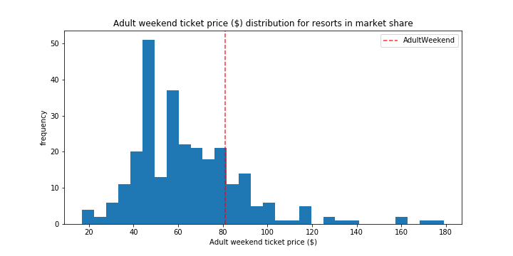
Modeling results and analysis
With respect to other resorts, Big Mountain (red dash) is currently underpriced.

Slide 6
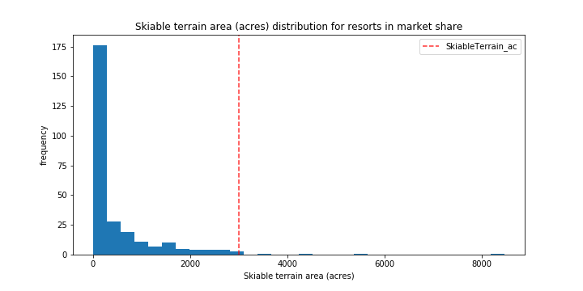
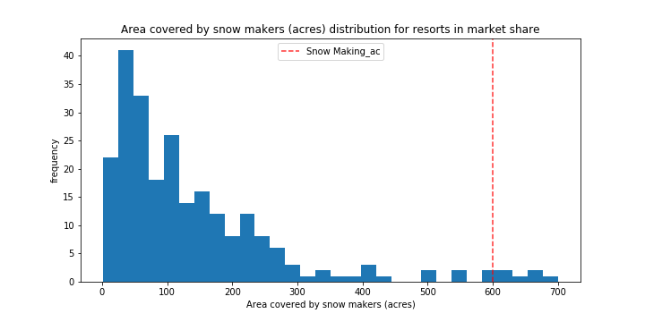
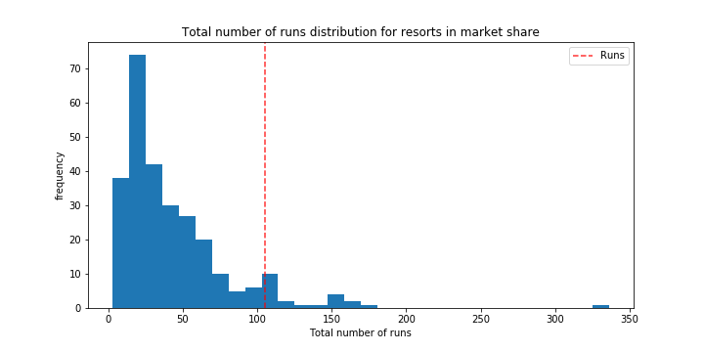
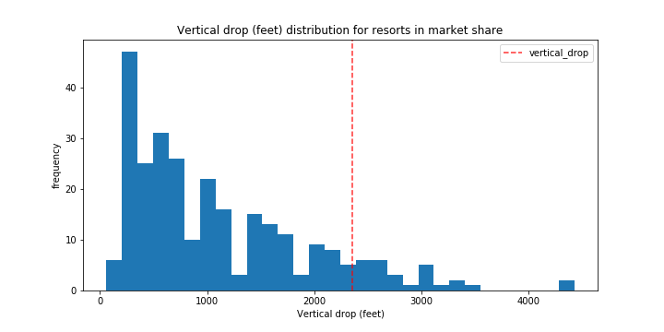
Modeling results and analysis
The reason is that Big Mountain (red dash) has one of the best facilities in the nation, where many of these features are highly correlated with the ticket price.
Snow maker area
Ski area
Number of runs
Vertical drop

Slide 7
Summary and conclusion
The current ticket price is sub-optimal. To ticket price can be further increased with a few changes to the facility.
The business team can use the ML model to explore different strategies to cut costs and increase revenue.

